Slide 1

Hardware and Software Review?
Questions?

Slide 2
Data Knowledge and Management
Chapter 5

Slide 3
Review: 5.1
Why is it so difficult to manage data?
What are prominent data sources?
What is Data Governance?
What is Data Hierarchy?

Slide 4
Review: 5.1
Why is it so difficult to manage data?
  Data increases exponentially with time
  Multiple sources of data
  New sources of data
  Data rot, or data degradation
  Data security, quality, and integrity
  Government Regulation

Slide 5
Review: 5.1
What are prominent data sources?
Internal Sources
  Corporate databases, company documents
Personal Sources
  Personal thoughts, opinions, experiences
External Sources
  Commercial databases, government reports, and corporate Web sites.
    Clickstream data

Slide 6
Review: 5.1
What is Data Governance?
is an approach to managing information across an entire organization involving a formal set of unambiguous rules for creating, collecting, handling, and protecting its information.

Slide 7
Review: 5.1
What is Data Hierarchy?
  Bit
  Byte
  Field
  Data File or Table
  Database

Slide 8
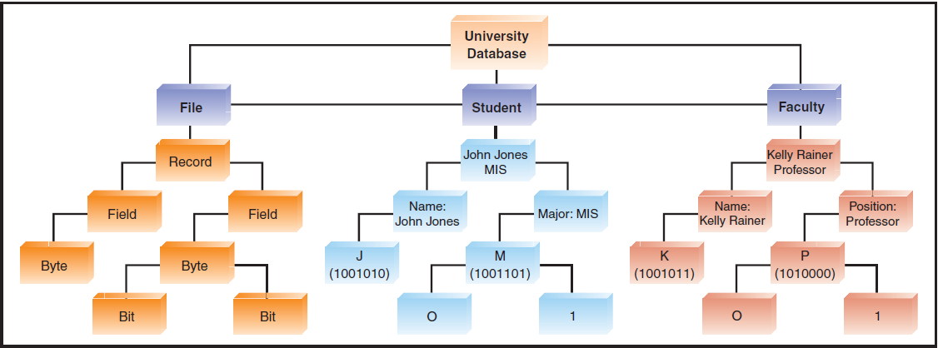
Review: 5.1

Slide 9

What is a Knowledge Graph?

Slide 10
Review 5.2
So, What is a Knowledge Graph?
What are the three main problems in Database Management?
What is the purpose of Database Management?
What do you understand by “Relational Database”?

Slide 11
Review 5.3
What is Big Data?
What are the characteristics of Big Data?
  Diverse, high-volume, high-velocity information assets that require new forms of processing to enable enhanced decision making, insight discovery, and process optimization. (www.gartner.com)
  Exhibit variety
  Includes structured, unstructured, and semi-structured data
  Are generated at high velocity with an uncertain pattern
  Do not fit neatly into traditional, structured, relational databases

Slide 12
Review 5.3
Characteristics?
Volume
Velocity
Variety

Slide 13

IBM data management
Notes:
https://www.ibm.com/analytics/data-management

Slide 14
IBM and YOU
Take a minute to think about how your last 48 hours of online activity provide information about who you are and potential ads/marketing.

Slide 15
5.4 Data Warehouse and Data Mart
What is the difference between a Warehouse and a Mart?
Data Warehouse
  A repository of historical data that are organized by subject to support decision makers in the organization
Data Mart
  A low-cost, scaled-down version of a data warehouse designed for end-user needs in a strategic business unit (SBU) or individual department.

Slide 16
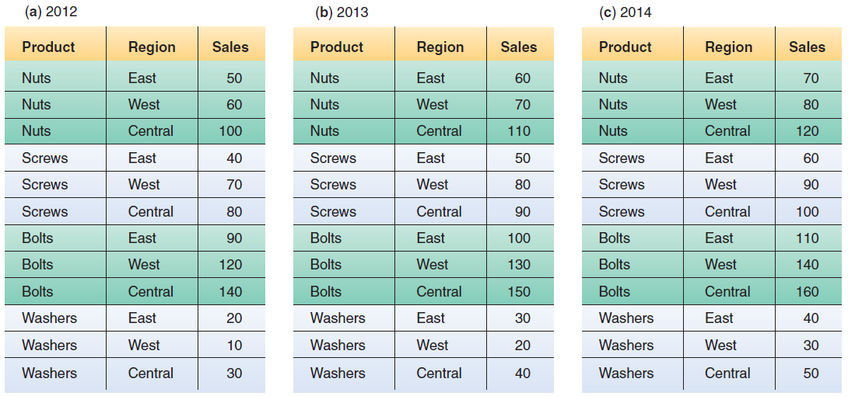
Relational Databased

Slide 17
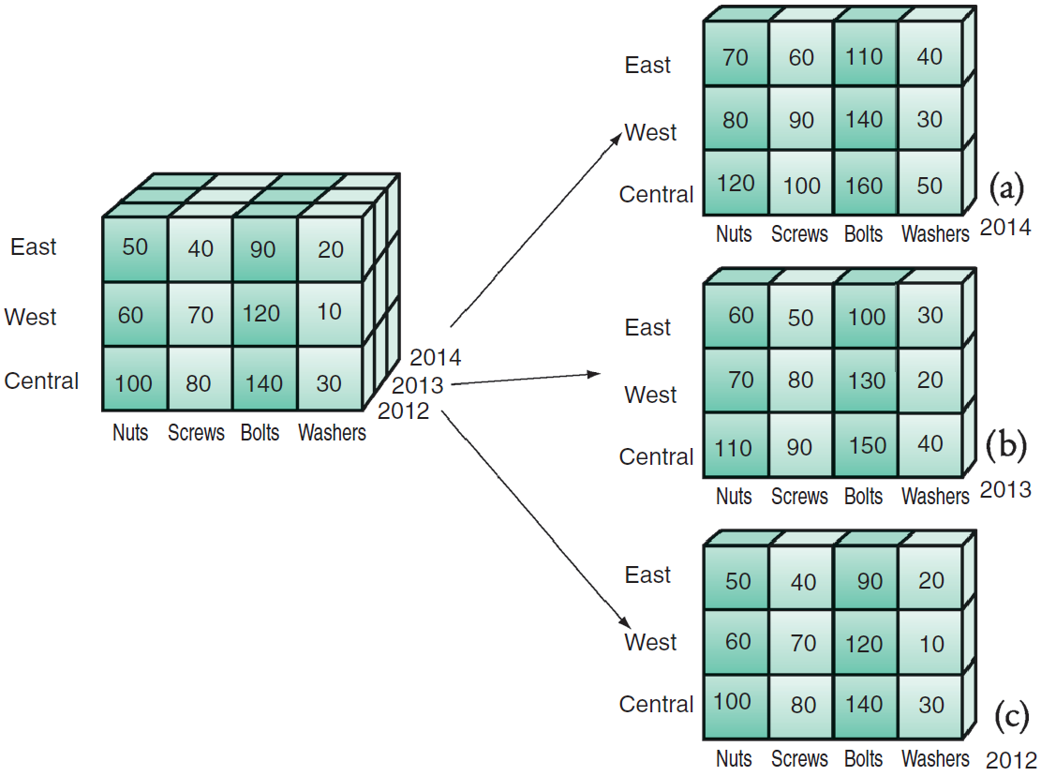
Data Cube

Slide 18
5.5 Knowledge Management
Give an example of Explicit Knowledge
Give an example of Tacit Knowledge
What is the KMS?
What are the steps in KMS?
Notes:
Explicit Knowledge: more objective, rational, and technical knowledge. In an organization, explicit knowledge consists of the policies, procedural guides, reports, products, strategies, goals, core competencies, and IT infrastructure of the enterprise.
Tacit Knowledge: the cumulative store of subjective or experiential learning. In an organization, tacit knowledge consists of an organization’s experiences, insights, expertise, know-how, trade secrets, skill sets, understanding, and learning. It is generally imprecise and costly to transfer.

Slide 19
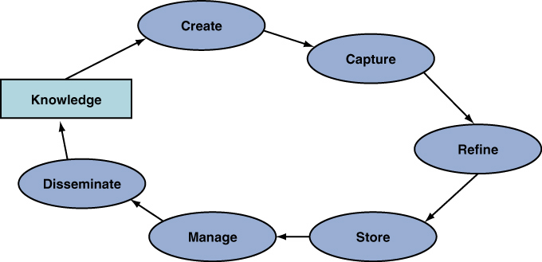
The KMS Cycle
Think of a concept, idea, thought, project, etc. that you have worked on that represents the KMS cycle.

